Slide 1



US ELECTIONS
2020-2021

Slide 2
VOCABULARY

Slide 3
NOUNS
A ballot - a piece of paper listing the candidates running for office. A ballot is used to cast a vote.
→ Un bulletin de vote
A ballot box - a box in which voters’ ballots are placed.
→ Une urne
A blue state: a state that is mainly supports and votes for Democratic candidates in presidential elections. These states are usually shown in blue on US election maps ( ≠ red states → Republican
→ Un état démocrate
A campaign - a series of political actions (like advertisements, public appearances, and debates) that are used to help a candidate get elected to office.
→ Une campagne

Slide 4
A candidate - a person who is running for office in an election
→ Un candidat
A citizen: a native or naturalized member of a state or nation who owes allegiance to its government and is entitled to its protection.
→ Un citoyen
An incumbent - a person who is currently in office.
→ Le president sortant
An issue : an important subject or problem to discuss or debate
→ Un problème
An oath of office: a formal promise a person makes to do the best he or she can in a particular job or political office. The president takes an oath of office on inauguration day.
→ Un serment d’allégeance

Slide 5
A platform - a formal written document that states a political party's stances on important issues and its goals for the future.
→ Un programme électoral
A policy : a deliberate act of government that in some way alters or influences the society or economy outside the government.
→ Une politique
A political party - an organized group of people with common values and goals, who try to get their candidates elected to office.
→ Un parti politique
A politician - a person who is active in politics
→ Un homme politique
Politics : the process by which governments make decisions
→ La politique
A poll - a survey of people (usually voters) that is taken to find out which candidate or issue they might vote for.
→ un vote/scrutin

Slide 6
Running Mate: A presidential candidate will choose another individual to run for vice-president. This person is the candidate's running mate.
→ Un candidat à la vice-présidence
A swing state : state whose voters do not follow a predictable pattern, Republican or Democrat
→ Un état susceptible de faire basculer le resultats des élections
A term ( of office ) : a period of time during which a position is held
→ Un mandat
A voting / polling booth - a small enclosure in which a person votes.
→ Un isoloir
The ( right/left ) wing : either of two groups with opposing views within a larger group
→ La droite ou la gauche / une tendance politique

Slide 7
VERBS
To be in office: to be in power
→ Etre au pouvoir
To campaign ( for / against ): to advertise oneself (or someone else) as a candidate in an upcoming election; to work towards getting oneself (or someone else) elected
→ Faire campagne ( pour ou contre )
To debate: to have a structured, formal argument about a controversial topic
→ débattre
To deliver a speech: to make a speech
→ Faire un discours
To elect : to choose someone to be a leader through a democratic vote
→élire

Slide 8
To resign: to give up an office or position
→ démissionner
To run for office: to campaign to be president, to try to become president
→ Se presenter aux élections
To cast a vote: to vote
→ voter
To support: to uphold and side with a person or policy
→ soutenir
Se présenter aux élections / soutenir / démissionner / élire / faire un discours / débattre / voter / être au pouvoir / faire campagne /

Slide 9
THE POLITICAL SYSTEM

Slide 10
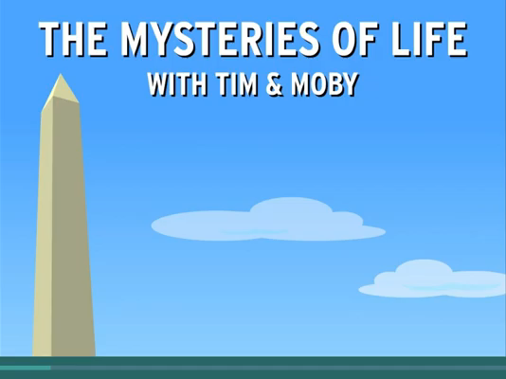

Slide 11
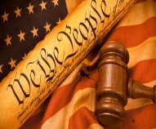
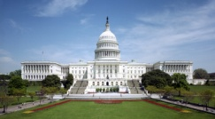
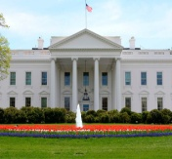
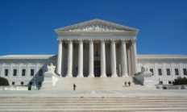


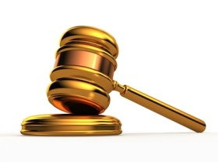
https://www.brainpop.com/socialstudies/usgovernment/branchesofgovernment/
US GOVERNMENT
3 BRANCHES
THE …………...…………….…….. BRANCH
THE …………….………...……….. BRANCH
THE …………...……………….….. BRANCH
PLACE: the ……………………………
PEOPLE: The ………….…………….. made of the ………………………. of ……………………………….. and the ………………………
JOB: They ……………………. laws
Explanations:
…………………………………………………………………………………………………………………..
PLACE : the …………………..……….
PEOPLE : the ………………………….
and his ……………………
……………………………….
+ the ……………………….
JOB: They ……………….. Laws
Explanations:
……………………………………………………………………………………………………………………
PLACE : the ………………….………..
PEOPLE : the ………………………….
………………………………..
composed of 9
………………………………..
JOB: They ……………………….. Laws
Explanations:
……………………………………………………………………………………………………………………

Slide 12
https://www.brainpop.com/socialstudies/usgovernment/branchesofgovernment/
US GOVERNMENT
3 BRANCHES
THE LEGISLATIVE BRANCH
THE EXECUTIVE BRANCH
THE JUDICIAL BRANCH
PLACE: the Capitol
PEOPLE: The Congress is made of the House of Representatives and the Senate
JOB: They create laws
Explanations:
They introduce bills that can become laws
House→ bills related to gvt’s spending
Senate → approves or rejects treaties with other countries
Approves or rejects presidential nominations
PLACE : the White House
PEOPLE : the president
and his vice-president
+ the Cabinet
JOB: They carry out Laws
Explanations:
Approves and recommends new laws
Directs national defense and foreign policy
The president is the commander in chief of the armed forces
The Cabinet advises the president on issues such as education, foreign policy, agriculture, defense
They make treaties
Prepare the budget
PLACE : the Supreme Court
PEOPLE : the Supreme Court
composed of 9 judges
( = justices )
JOB: They interpret Laws
Explanations:
They rule on cases that may conflict with constitution, decide whether the laws are unconstitutional

Slide 13
Why is it a system of checks and balances ? Give at least 2 examples
→The Founders of the USA didn’t want any of one branch to have too much power so each branch of the government is limited by the other two in different ways
ex: The president can decide to veto a bill presented by Congress but Congress can override that veto if 2/3 of representatives agree. If Supreme Court decides the law is unconstitutional, the law disappears
ex: The president’s Cabinet members have to be approved by a majority of Congress
ex: The 9 justices at the Supreme Court serve for life but they have to be appointed by the president and approved by the Senate
ex: Congress can also remove justices from their post by a process called impeachment
ex: Supreme Court can declare the actions of the president unconstitutional and Congress can remove president from office by impeachment

Slide 14
GRAMMAR
Make 5 sentences about the US political system using
comparison ( structures or lining words )
→ We can think that the president is more powerful than the
Congress and the Supreme Court but it is not true.
→ The executive has almost the same power as / as much power
as the other two branches.
→ The Congress creates laws whereas / while the Supreme Court
interprets them.
→ The 9 justices can veto a bill unlike / contrary to the Congress.

Slide 15
TO GO FURTHER..
CHECKS AND BALANCES

Slide 16
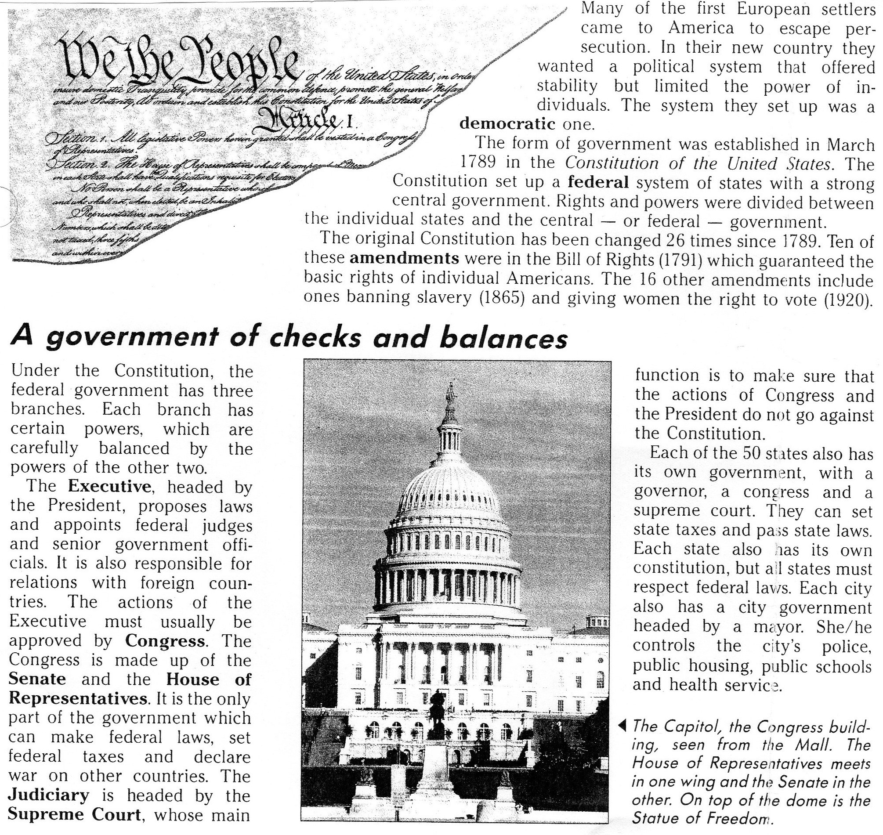

Slide 17
1. Why did Europeans decide to come and settle in America ?
2. In which official document can you find the principles of the American government ? When was it signed
3. Pick out 2 adjectives that qualify the system the first European settlers set up ?
4. What is the Bill of Rights ?
5. Name the 3 branches of the government, what they do and say who is in charge.
6. What is the system of checks and balances ? Pick out a sentence to justify your answer.
7. Why did the early settlers agreed on such a system ? Pick out a sentence to justify your answer.

Slide 18
Why did Europeans decide to come and settle in America ?
→ The Europeans decided to come and settle in America to escape persecutions
In which official document can you find the principles of the American government ? When was it signed ?
→ The principles of the US government can be found in the Constitution which was signed in 1789
Pick out 2 adjectives that qualify the system the first European settlers set up ?
→ Democratic and federal
What is the Bill of Rights ?
→ Amendments to the Constitution to guarantee the basic rights of individual Americans
Name the 3 branches of the government, what they do and say who is in charge.
→ The Executive / proposes laws, appoints federal judges, senior gvt officials, relations with foreign countries / president
→The Legislative / makes federal laws, sets federal taxes and declares war / the Congress
→ The Judicial / makes sure the actions of Congress and president don’t go against Constitution
What is the system of checks and balances ? Pick out a sentence to justify your answer.
→ Each branch checks on the other two to make sure there isn’t too much power in the hands of only one : “Under the Constitution, the federal gvt has three branches. Each branch has certain powers, which are carefully balanced by the powers of the other two”
Why did the early settlers agree on such a system ? Pick out a sentence to justify your answer.
→ The early settlers agreed on such a system not to become a monarchy or didactorship: “In their new country, they wanted a political system that offered stability but limited the power of individuals”

Slide 19
THE ELECTION PROCESS
https://www.youtube.com/watch?v=MW8IKcqrseM

Slide 20
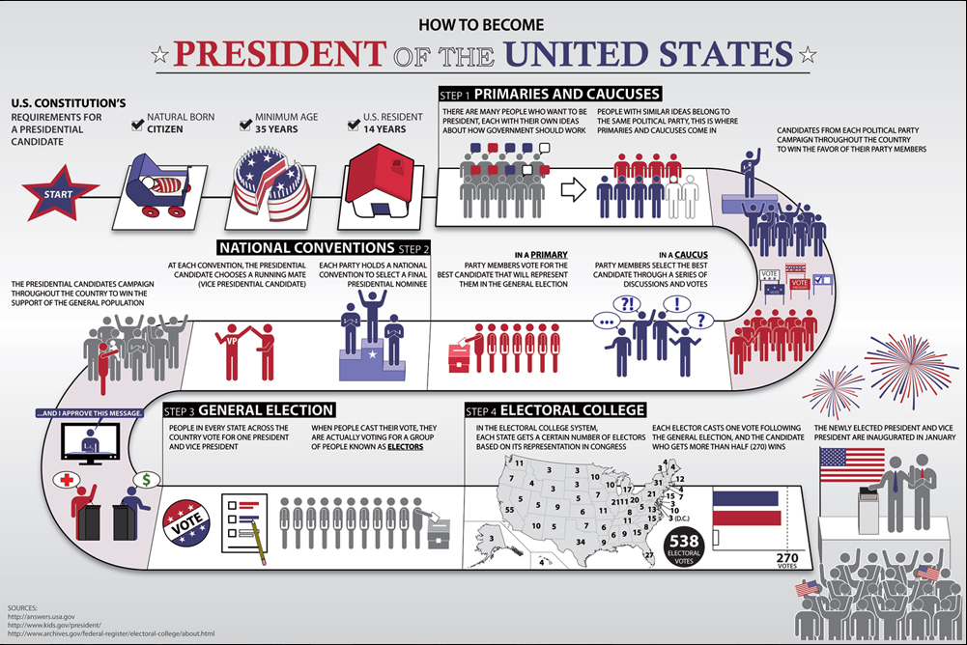
CAMPAIGN: win the battleground states ≠ strongholds
6 weeks later

Slide 21
With the help of the poster, see if you can answer these questions !
What are the 3 requirements to become president of the US ?
What are the 2 main political parties and what are their symbols ?
What are the steps to becoming President ?
What happens during the Primaries and Caucuses ?
What decision is made during the National Convention ?
Do people actually vote for the president or electors ?
What is the electoral college ?
When are the President and Vice-President inaugurated ?
Now watch the video to complete your answers.
https://www.youtube.com/watch?v=2eXCG-hlaqI

Slide 22
CORRECTION
1. What are the 3 requirements to become president of the US ?
→ You must be 35 years old, be a natural born citizen and have been a US
resident for at least 14 years.
2. What are the 2 main political parties and what are their symbols ?
→ The two main parties in the US are the Republican Party and the Democrat
Party. The donkey is the symbol for the Democrats, the donkey for the
Republicans.
3. What are the steps to becoming President ?
→First of all, Candidates campaign around the country to win the party’s
nomination. Then during the Caucuses, party members meet, discuss and vote
for who should be the best party candidate.
In Primaries, party members vote in a state election for the candidate they
want to represent them in the General Election.
4. What happens during the Primaries and Caucuses ?
→Each of the main Parties hold a convention to nominate their presidential
candidate. The candidate also nominates their vice-presidential candidate.

Slide 23
5. What decision is made during the National Convention ?
→ Each of the main Parties hold a convention to nominate their presidential
candidate. The candidate also nominates their vice-presidential candidate.
6. Do people actually vote for the president or electors ?
→ On election day, in every state people cast their vote. When they cast their
vote, they are actually voting for a group of people called electors. The
number of electors for each state is equal to the total number of
representatives and senators that state has elected to the house of
representatives and the Senate.
7. What is the electoral college ?
→ 538 electors form the electoral college, therefore to win the election, the
candidate must secure the votes of 270 electors.
8. When are the President and Vice-President inaugurated ?
→ They are inaugurated on the 20th of January.

Slide 24
How to become president of the USA
The minimum constitutional requirements to become
president of the USA are:
To be a natural born citizen
To be at least 35
To have been a US resident for 14 years
You HAVE TO be a natural born citizen
You HAVE TO be at least 35 years old / you need to be..
You MUST have lived for 14 years on American soil/ the first requirement is to have been an American resident for at least 14 years

Slide 25
With the help of the document, put the different steps in the chronological order and then match them with their explanations
  Candidates from each political party campaign throughout the country to win the favour of their party members
  Each state has a certain number of electors depending on its population. Each elector casts a vote following the general elections. The candidate who gets more than half of the vote in the state, gets all the electors of the state. Finally, the candidate who gets more than half of the electors in the country, is the new president. This is the « winner-take-all » method.
  Citizens vote but don’t directly elect the president. In each state, they vote for a list of electors who represent the “ticket”( = president + vice-president ) of their choice
  The president is sworn in and takes office.
  2 meetings in the summer during which each party agrees on one presidential candidate to represent their party. That candidate chooses a “running mate” for vice-president.
Inauguration Day
Primaries and caucuses
Electoral college
General elections
National conventions

Slide 26
THE ROAD TO THE WHITE HOUSE
Using both the previous document + the cartoon entitled the road to the White House, give the different stages to
the White House and explain what they consist in:
  Primaries or caucuses
  Candidates from each political party campaign throughout the country to win the favour of their party
  members
  National conventions
2 meetings in the summer during which each party agrees on one presidential candidate to represent
their party. That candidate chooses a “running mate” for vice-president.
  General elections
Citizens vote but don’t directly elect the president. In each state, they vote for a list of electors who
represent the “ticket”( = president + vice-president ) of their choice
  Electoral college
  Each state has a certain number of electors depending on its population. Each elector casts a vote
  following the general elections. The candidate who gets more than half of the vote in the state, gets all
  the electors of the state. Finally, the candidate who gets more than half of the electors in the country, is
  the new president. This is the « winner-take-all » method.
  Inauguration day
The president is sworn in and takes office.

Slide 27
TO GO FURTHER..
POPULAR VOTE VERSUS ELECTORAL VOTE

Slide 28
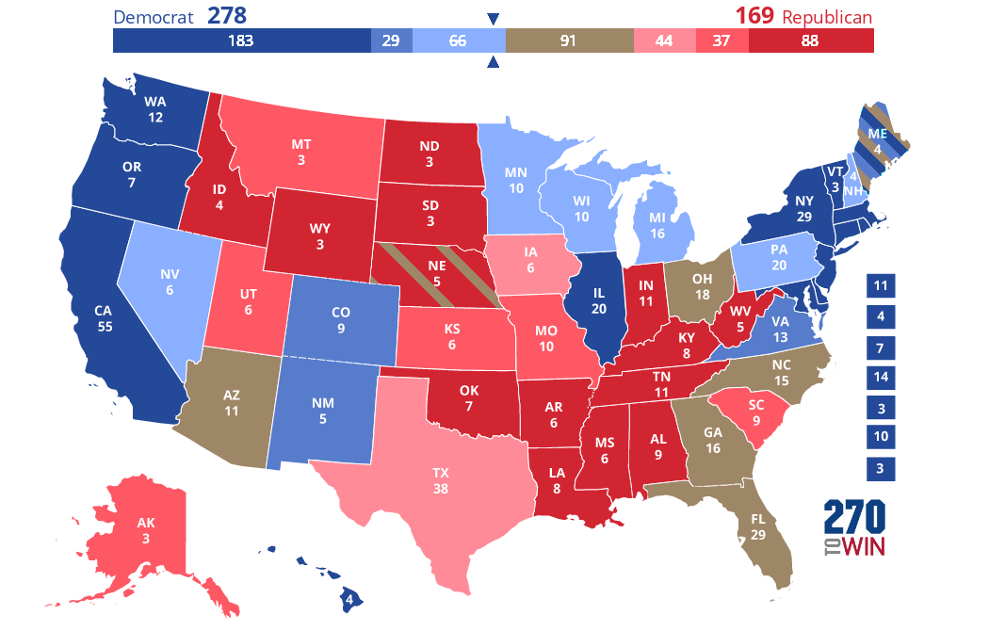

Slide 29
The winner-take-all method
Reminder: The US system is one of indirect universal suffrage so US citizens vote for presidential electors who have pledged to vote for one of the two “tickets” (president and vice-president ). Their number per state is equal to the number of senators and representatives that the state has in congress.

Slide 30
Let’s imagine for one moment that the USA is composed of only 10 states..
1. Find the number of electors for
each state:
- Ohio =
- New-York =
- Florida =
- Missouri=
- California =
- Oregon =
- Montana =
- Alabama =
- Illinois=
- Texas =
2- Give the total number of electors:
→ ……………………………………............
( in real life= 538 )

Slide 31
3- November 8th : American citizens have voted and here are the results:
STATES | CANDIDATE A | CANDIDATE B
OHIO | 6 | 12
NEW YORK | 7 | 22
FLORIDA | 9 | 20
MISSOURI | 4 | 6
CALIFORNIA | 28 | 27
OREGON | 2 | 5
MONTANA | 1 | 2
ALABAMA | 2 | 7
ILLINOIS | 11 | 9
TEXAS | 21 | 17
How many electors for Candidate A ?
→ ………………………………………………….....
How many electors for Candidate B ?
→ ………………………………………………………
Who has won the popular vote ?
→ ……………………………………………..
Who has won the electoral vote ? You need to apply the “winner-take-all” method that is to say the candidate who gets the higher score, wins his own electors + the other candidate’s.
→ Candidate A: .......... electors
→ Candidate B: .......... electors
So the new president is: .................... with ............... states

Slide 32
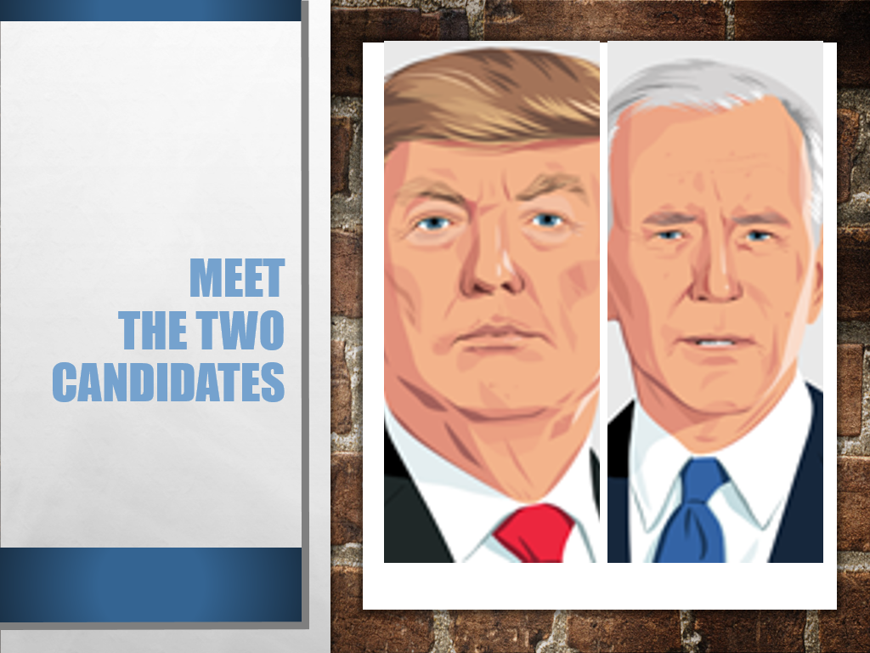
Meet the two candidates

Slide 33
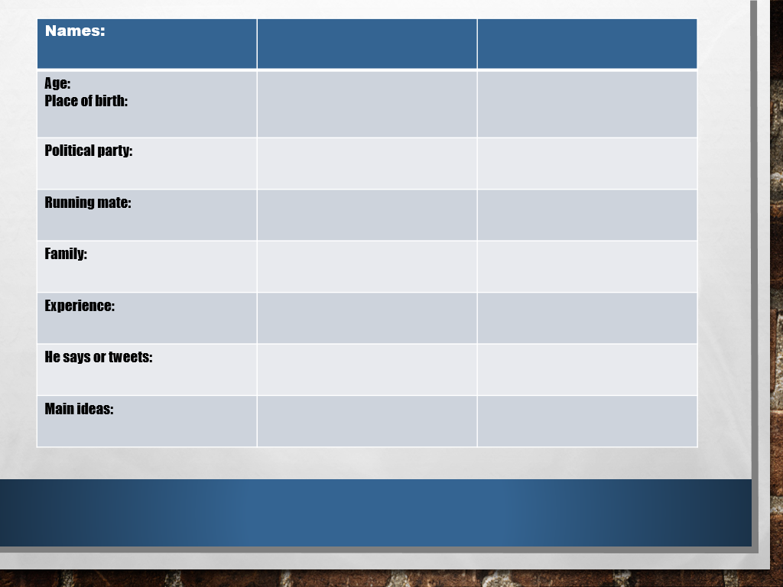

Slide 34
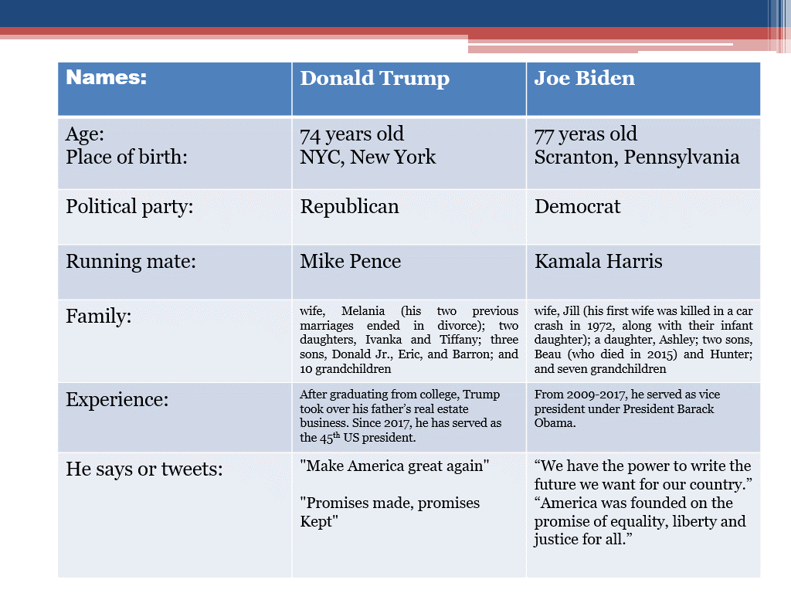

Slide 35
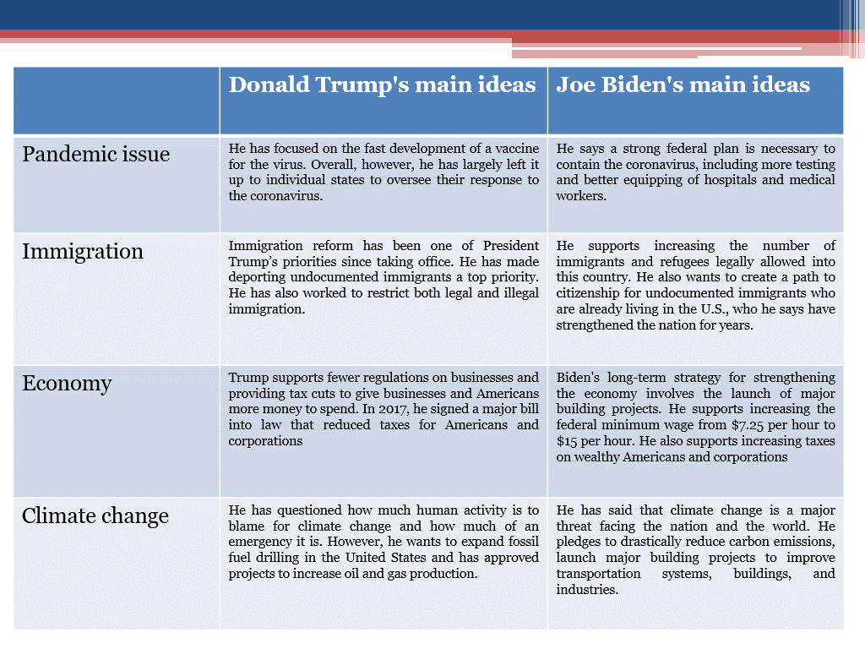

Slide 36
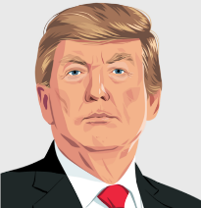
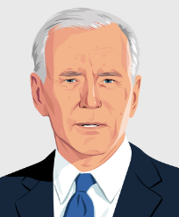
Promotional videos
Watch these 2 short promotional videos to understand what the 2 main candidates propose if they are elected in November.
Donald Trump https://www.youtube.com/watch?v=Ws66liLKGzA
What is Donald Trump's message ? What does he stand for or against ? Pick out keywords.
What sound effects are used and how does this influence the overall message?
(dramatic/uplifting/inspiring/fearful music)
Is this video effective, why, why not?
Joe Biden https://www.youtube.com/watch?v=CV1la96XHqE
What is Joe Biden’s message? What does he stand for or against? Pick out key words.
What is the main strategy used by Biden to be convincing?
Which historical figure is used? Why?
What kind of music is used?
RECAP !
Compare the message in both campaign videos using expressions of comparison: on the one hand, on the other… whereas/unlike… contrary to …)

Slide 37
TO GO FURTHER..
HOW TO CONVINCE

Slide 38
BRAINSTORMING
In groups, discuss about the best strategies to deliver a CONVINCING speech and fill in the following grid:
Body language | Speech techniques
Body language | Speech techniques
Eye contact No reading Hands Enthusiastic / convinced Natural / spontaneous Stand straight Voice: clear and loud enough Rhythm / pauses Tone of voice Stress key words | Humour ( personal ) anecdotes Catchy introduction Repetitions Short sentences Easy words Synthesis Clear argumentation Engage or challenge the audience: questions Imperative form -play on emotions

Slide 39
FINAL PROJECT OPTION 1
Your team of 2 will create the ideal presidential candidate and his/her running mate for the 2016 US elections. You will deliver a speech to convince your audience that they should vote for you.
It will be a 4’ presentation ( 2’ each ) during which you will:
→ present yourself (name, age, ethnicity, education, work experience, marital status,
a few fun facts )
→ why you have decided to go into politics and join this political party in particular
( Democratic or Republican ), give the slogan of your campaign, present 2 of your
key issues and your promises to the American people
. you may have notes but ONLY KEY WORDS
. bear in mind that you want to CONVINCE so use all the necessary STRATEGIES
. you have carte blanche as to the organisation of all these elements and the special effects or
illustrations ( Power Point, props or any other ) that you would think useful

Slide 40

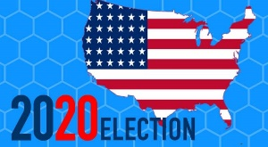
Final project option 2
Final Task: Tonight is the first TV debate between the two candidates: Joe Biden and Donald Trump. US citizens are eager on listening to their platforms and learning more about the candidates.

Slide 41
In groups of four people, you will perform the show:
One student: TV presenter
His/Her role: → Introduce the show, the candidates, and the guest.
→ Ask questions on the candidates ’platforms (2 issues)
→ Conclude
One student: Donald Trump
His/Her role: → Talk about some precise points of your platform
→ Refer to the US political system
→ Be ready to convince the guest.
One student: Joe Biden
His/Her role: → Talk about precise points of your platform
→ Refer to the US electing process
→ Be ready to convince the guest.
One student: a US citizen (guest)
His/Her role: This US citizen doesn’t know who he/she is going to cast a vote for.
→ Introduce himself/herself
→ Talk about his/her job,
→ Talk about his/her family
→ Talk about his/her personal issues.
He/she must make his/her decision at the end of the show.

Slide 42
CONNECTION AXES ?
List the documents that have been studied throughout the unit and see whether you can find a connection with one or several axes for each of them.

