Slide 1


GRAMMAR CHALLENGE
Correction of WS 8

Slide 2
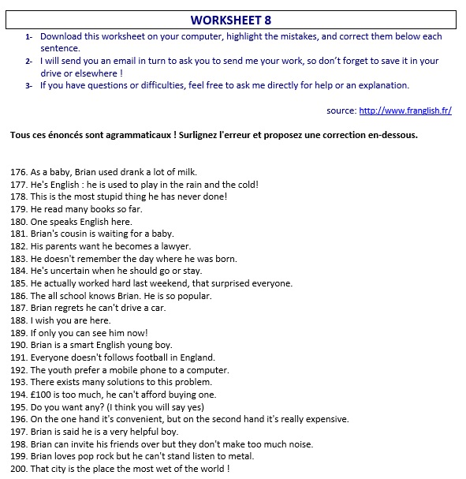
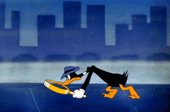

Slide 3
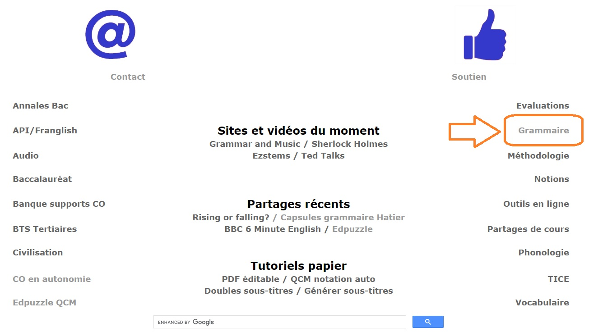
http://www.franglish.fr/

Slide 4
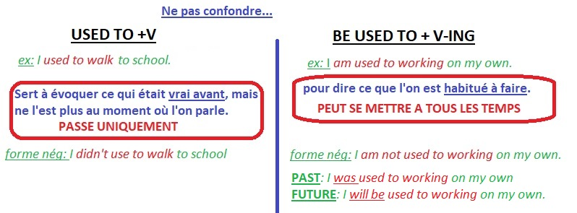
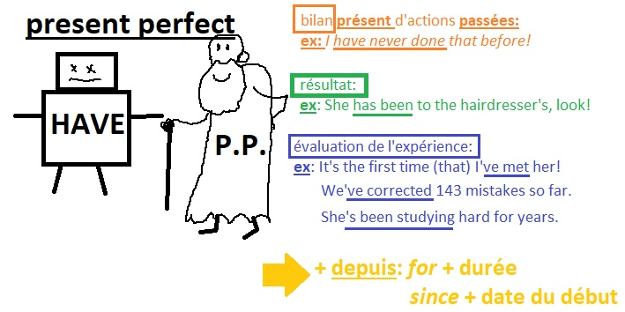
176. As a baby, Brian used drank a lot of milk.
He used to drink (used to + V)
177. He's English : he is used to play in the rain and the cold!
He is used to playing (be used to +V-ING)
178. This is the most stupid thing he has never done!
he has ever done
179. He read many books so far.
He has read
180. One speaks English here.
English is spoken here (“on” impersonnel)

Slide 5
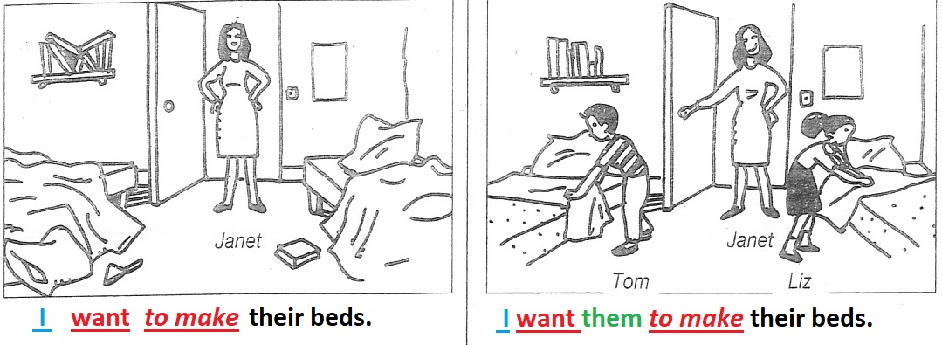
181. Brian's cousin is waiting for a baby.
is expecting a baby
(to expect a baby)
182. His parents want he becomes a lawyer.
They want him to become (want sb to do sthg)
183. He doesn't remember the day where he was born.
the day when
184. He's uncertain when he should go or stay.
whether…or…
185. He actually worked hard last weekend, that surprised everyone.
which

Slide 6
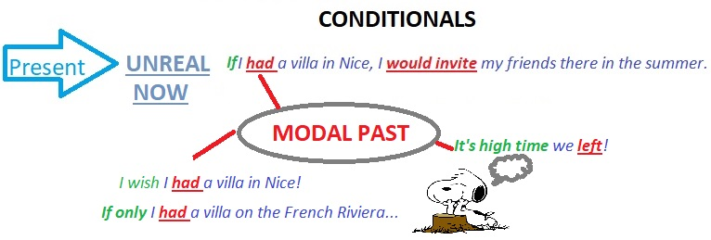
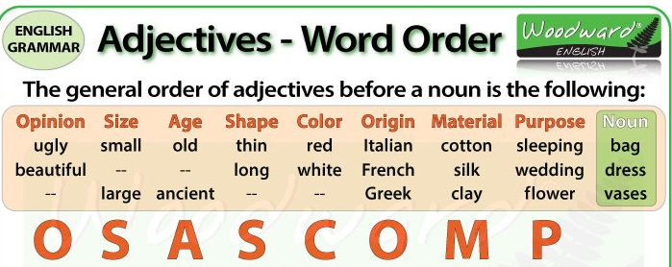
186. The all school knows Brian. He is so popular.
All the school / The whole school
187. Brian regrets he can't drive a car.
He regrets not being able/allowed to drive a car.
188. I wish you are here.
were
189. If only you can see him now!
could
190. Brian is a smart English young boy.
a smart young English boy.
Opinion Age Origin

Slide 7
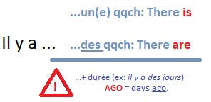

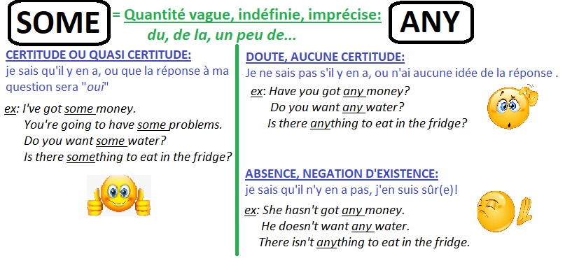
191. Everyone doesn't follows football in England.
follow
192. The youth prefer a mobile phone to a computer.
The young/ Young people
193. There exists many solutions to this problem.
There are
194. £100 is too much, he can't afford buying one.
he can’t afford to buy
195. Do you want any? (I think you will say yes)
some

Slide 8
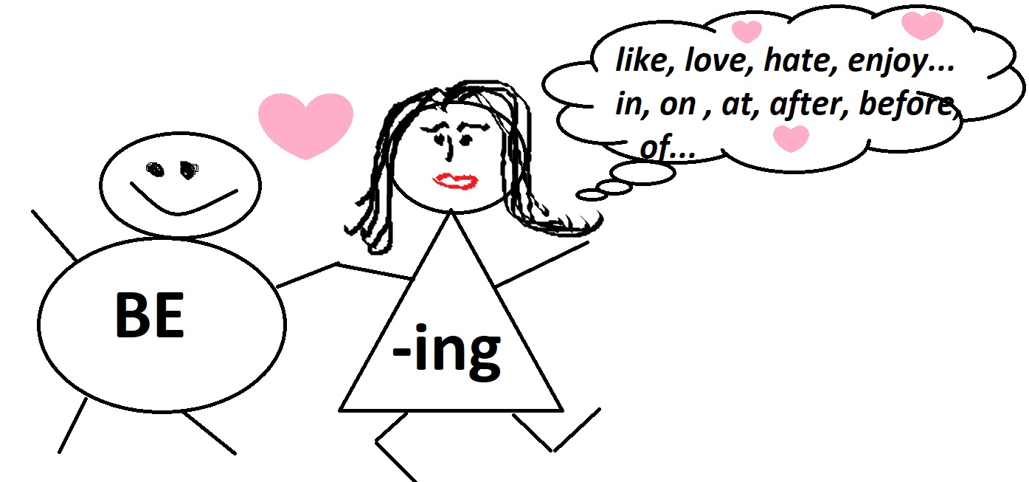

196. On the one hand it's convenient, but on the second hand it's really expensive.
On the one hand, …on the other hand
197. Brian is said he is a very helpful boy.
B. is said to be
198. Brian can invite his friends over but they don't make too much noise.
provided/on the condition that
199. Brian loves pop rock but he can't stand listen to metal.
He can’t stand listening
200. That city is the place the most wet of the world !
the wettest place of the world

Slide 9


