Slide 1


GRAMMAR CHALLENGE
Correction of WS 6
Mme Tanter, Lycée Ste Thérèse, 29000 QUIMPER, ac-rennes.

Slide 2
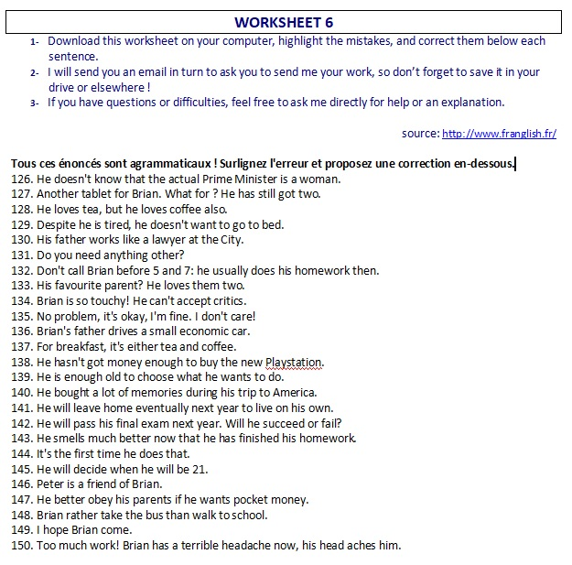


Slide 3
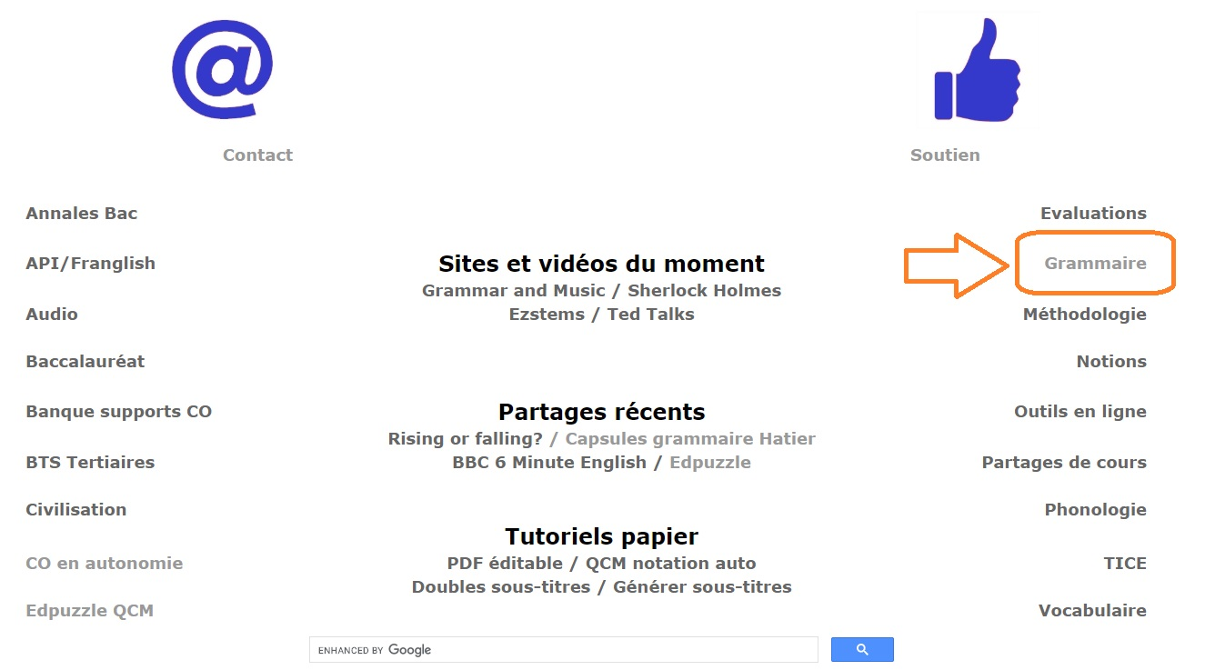
http://www.franglish.fr/

Slide 4

126. He doesn't know that the actual Prime Minister is a woman.
current (actual = real)
127. Another tablet for Brian. What for ? He has still got two.
already
128. He loves tea, but he loves coffee also.
too/ better
129. Despite he is tired, he doesn't want to go to bed.
Although(prop) / Despite the fact that (+prop)
Or: Despite his tiredness (despite + GN) / in spite of his tiredness (in spite of +GN)
130. His father works like a lawyer at the City.
as

Slide 5
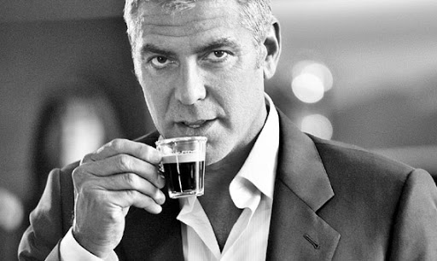
131. Do you need anything other?
anything else
132. Don't call Brian before 5 and 7: he usually does his homework then.
between…and…
133. His favourite parent? He loves them two.
both(or: he loves both of them)
134. Brian is so touchy! He can't accept critics.
criticism
135. No problem, it's okay, I'm fine. I don't care!
mind
136. Brian's father drives a small economic car.
a cheap /fuel-efficient car / an economy car

Slide 6
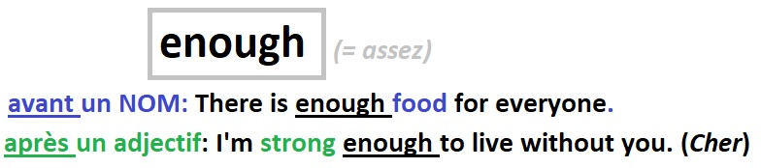
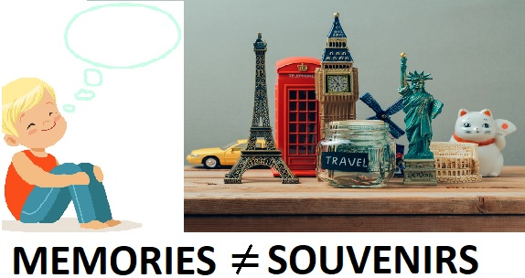
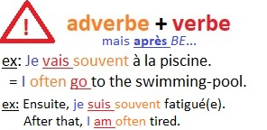
137. For breakfast, it's either tea and coffee.
either…or…
138. He hasn't got money enough to buy the new Playstation.
enough money
139. He is enough old to choose what he wants to do.
old enough
140. He bought a lot of memories during his trip to America.
souvenirs
141. He will leave home eventually next year to live on his own.
He will eventually leave home (nb: eventually = finally)
Or: Maybe he will leave home…/ He may leave home…

Slide 7
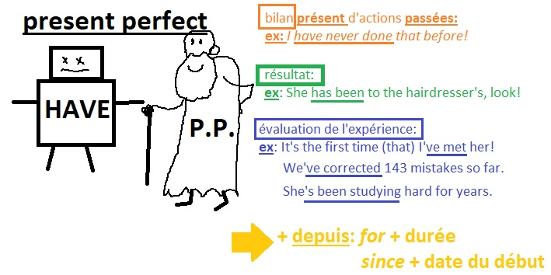
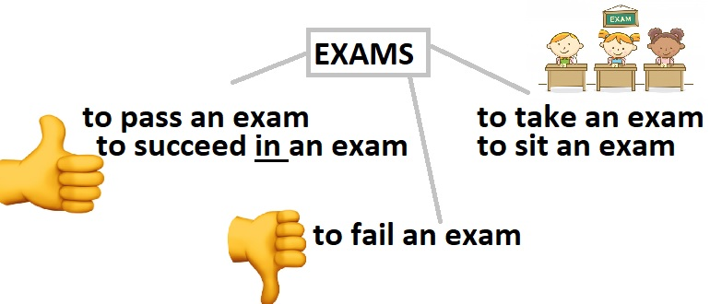
142. He will pass his final exam next year. Will he succeed or fail?
take/ sit
143. He smells much better now that he has finished his homework.
feels
144. It's the first time he does that.
has done
145. He will decide when he will be 21.
when he is (nb: jamais will dans une subordonnée!)
146. Peter is a friend of Brian.
of Brian’s.

Slide 8
147. He better obey his parents if he wants pocket money.
He’d better (“ferait mieux de”: had better+BV)
148. Brian rather take the bus than walk to school.
‘d rather (“préférerait”: would rather+BV)
149. I hope Brian come.
will come (or: is coming)
150. Too much work! Brian has a terrible headache now, his head aches him.
hurts.

Slide 9
