Slide 1


GRAMMAR CHALLENGE
Correction WS4
Mme Tanter, Lycée Ste Thérèse, 29000 QUIMPER, ac-rennes.

Slide 2
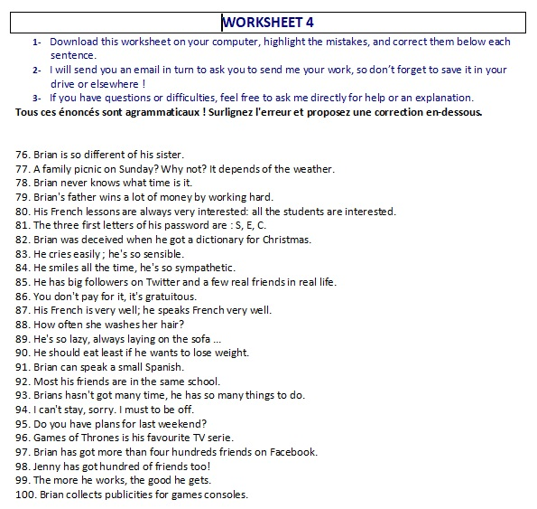

Slide 3
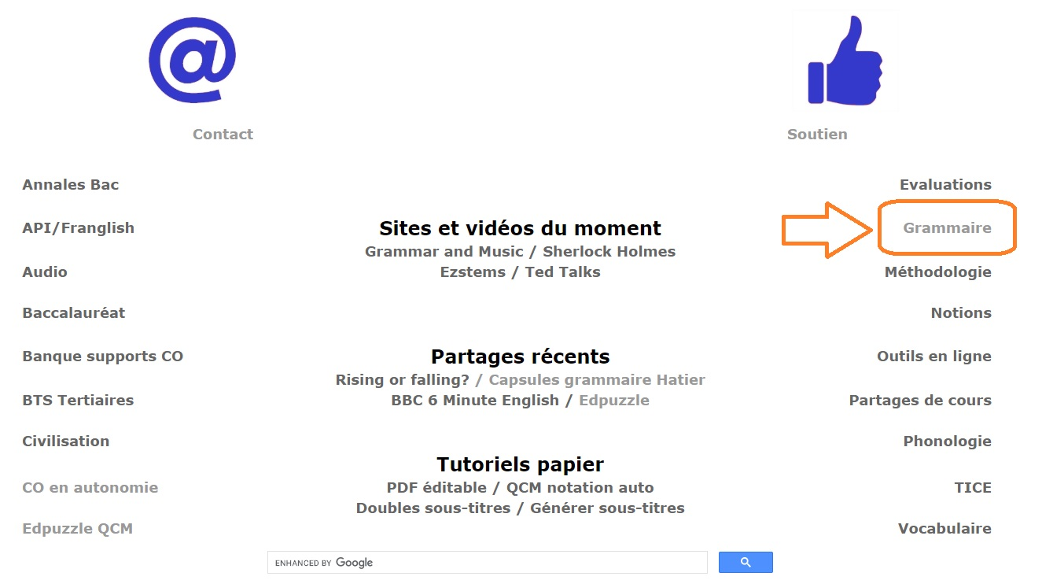
http://www.franglish.fr/

Slide 4
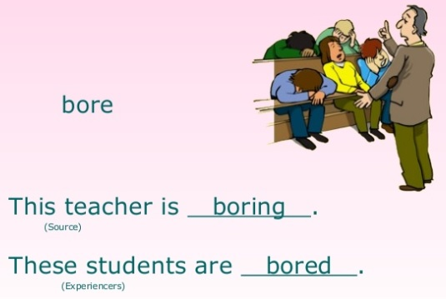
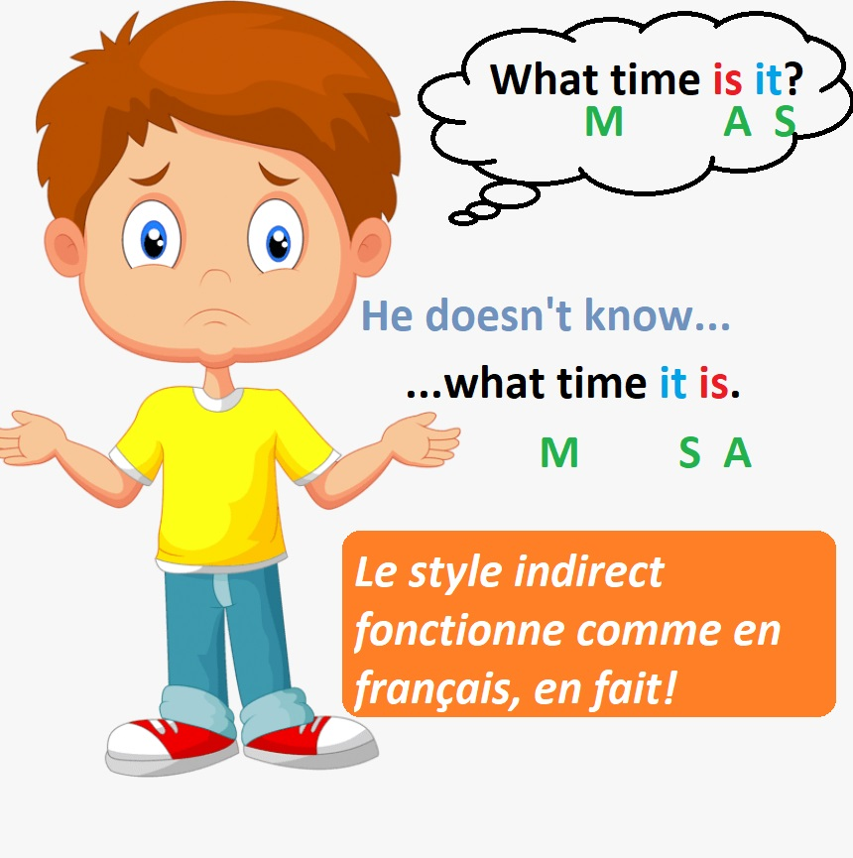
76. Brian is so different of his sister.
different from
77. A family picnic on Sunday? Why not? It depends of the weather.
It depends on
78. Brian never knows what time is it.
it is.
79. Brian's father wins a lot of money by working hard.
earns
80. His French lessons are always very interested: all the students are interested.
interesting

Slide 5

81. The three first letters of his password are : S, E, C.
The first three letters
82. Brian was deceived when he got a dictionary for Christmas.
disappointed
83. He cries easily ; he's so sensible.
sensitive (sensible = intelligent, with a good sense)
84. He smiles all the time, he's so sympathetic.
friendly (sympathetic = pitying)
85. He has big followers on Twitter and a few real friends in real life.
many/a lot of
86. You don't pay for it, it's gratuitous.
free (gratuitous = unjustified)

Slide 6

87. His French is very well; he speaks French very well.
good
88. How often she washes her hair?
How often does she wash (Q= MASVC?)
89. He's so lazy, always laying on the sofa ...
lying
90. He should eat least if he wants to lose weight.
less
91. Brian can speak a small Spanish.
a little/ a bit of
92. Most his friends are in the same school.
Most of his friends

Slide 7
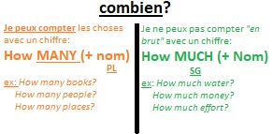
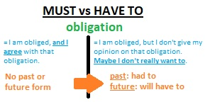
93. Brians hasn't got many time, he has so many things to do.
Brian much time
94. I can't stay, sorry. I must to be off.
must be / have to be
95. Do you have plans for last weekend?
next
96. Games of Thrones is his favourite TV serie.
series

Slide 8
97. Brian has got more than four hundreds friends on Facebook.
four hundred
98. Jenny has got hundred of friends too!
hundreds
99. The more he works, the good he gets.
the better
“The more, the better!”
100. Brian collects publicities for games consoles.
advertisements/adverts/ads for game consoles
(publicity SG = promotion, propaganda)

Slide 9


